Slide 1
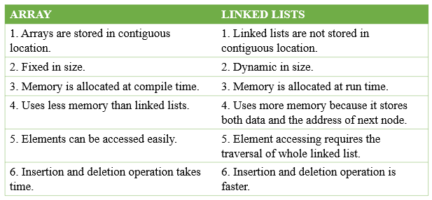
Difference between Array & Linked List

Slide 2
Linked list
Linked list is a linear data structure that includes a series of connected nodes. Linked list can be defined as the nodes that are randomly stored in the memory. A node in the linked list contains two parts, i.e., first is the data part and second is the address part. The last node of the list contains a pointer to the null. After array, linked list is the second most used data structure. In a linked list, every link contains a connection to another link.
Representation of a Linked list
Linked list can be represented as the connection of nodes in which each node points to the next node of the list. The representation of the linked list is shown below -

Slide 3
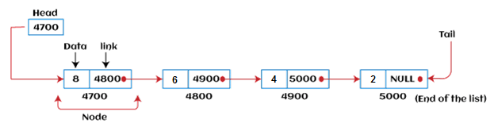
Representation of a Linked list
Linked list can be represented as the connection of nodes in which each node points to the next node of the list. The representation of the linked list is shown below -
Till now, we have been using array data structure to organize the group of elements that are to be stored individually in the memory. However, Array has several advantages and disadvantages that must be known to decide the data structure that will be used throughout the program.

Slide 4
How to declare a linked list?
It is simple to declare an array, as it is of single type, while the declaration of linked list is a bit more typical than array. Linked list contains two parts, and both are of different types, i.e., one is the simple variable, while another is the pointer variable. We can declare the linked list by using the user-defined data type structure.
The declaration of linked list is given as follows -
struct node
{
int data;
struct node *next;
}
In the above declaration, we have defined a structure named as node that contains two variables, one is data that is of integer type, and another one is next that is a pointer which contains the address of next node.

Slide 5
Types of Linked list
Linked list is classified into the following types -
Singly-linked list - Singly linked list can be defined as the collection of an ordered set of elements. A node in the singly linked list consists of two parts: data part and link part. Data part of the node stores actual information that is to be represented by the node, while the link part of the node stores the address of its immediate successor.
Doubly linked list - Doubly linked list is a complex type of linked list in which a node contains a pointer to the previous as well as the next node in the sequence. Therefore, in a doubly-linked list, a node consists of three parts: node data, pointer to the next node in sequence (next pointer), and pointer to the previous node (previous pointer).
Circular singly linked list - In a circular singly linked list, the last node of the list contains a pointer to the first node of the list. We can have circular singly linked list as well as circular doubly linked list.
Circular doubly linked list - Circular doubly linked list is a more complex type of data structure in which a node contains pointers to its previous node as well as the next node. Circular doubly linked list doesn't contain NULL in any of the nodes. The last node of the list contains the address of the first node of the list. The first node of the list also contains the address of the last node in its previous pointer.

Slide 6
Advantages of Linked list
The advantages of using the Linked list are given as follows -
Dynamic data structure - The size of the linked list may vary according to the requirements. Linked list does not have a fixed size.
Insertion and deletion - Unlike arrays, insertion, and deletion in linked list is easier. Array elements are stored in the consecutive location, whereas the elements in the linked list are stored at a random location. To insert or delete an element in an array, we have to shift the elements for creating the space. Whereas, in linked list, instead of shifting, we just have to update the address of the pointer of the node.
Memory efficient - The size of a linked list can grow or shrink according to the requirements, so memory consumption in linked list is efficient.
Implementation - We can implement both stacks and queues using linked list.

Slide 7
Disadvantages of Linked list
The limitations of using the Linked list are given as follows -
Memory usage - In linked list, node occupies more memory than array. Each node of the linked list occupies two types of variables, i.e., one is a simple variable, and another one is the pointer variable.
Traversal - Traversal is not easy in the linked list. If we have to access an element in the linked list, we cannot access it randomly, while in case of array we can randomly access it by index. For example, if we want to access the 3rd node, then we need to traverse all the nodes before it. So, the time required to access a particular node is large.
Reverse traversing - Backtracking or reverse traversing is difficult in a linked list. In a doubly-linked list, it is easier but requires more memory to store the back pointer.

Slide 8
Applications of Linked list
The applications of the Linked list are given as follows -
With the help of a linked list, the polynomials can be represented as well as we can perform the operations on the polynomial.
A linked list can be used to represent the sparse matrix.
The various operations like student's details, employee's details, or product details can be implemented using the linked list as the linked list uses the structure data type that can hold different data types.
Using linked list, we can implement stack, queue, tree, and other various data structures.
The graph is a collection of edges and vertices, and the graph can be represented as an adjacency matrix and adjacency list. If we want to represent the graph as an adjacency matrix, then it can be implemented as an array. If we want to represent the graph as an adjacency list, then it can be implemented as a linked list.
A linked list can be used to implement dynamic memory allocation. The dynamic memory allocation is the memory allocation done at the run-time.

Slide 9
Operations performed on Linked list
The basic operations that are supported by a list are mentioned as follows -
Insertion - This operation is performed to add an element into the list.
Deletion - It is performed to delete an operation from the list.
Display - It is performed to display the elements of the list.
Search - It is performed to search an element from the list using the given key.

Slide 10
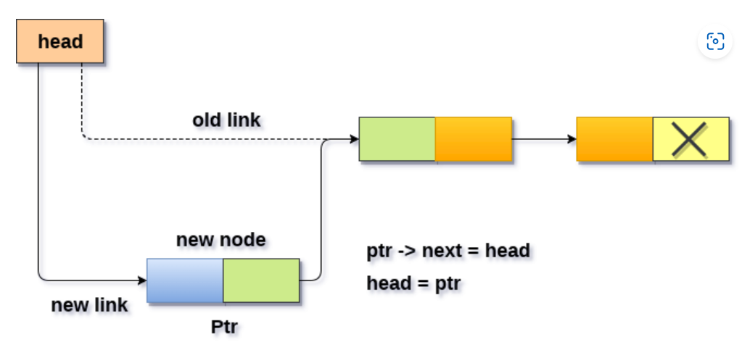
Insertion in singly linked list at beginning
Inserting a new element into a singly linked list at beginning is quite simple. We just need to make a few adjustments in the node links. There are the following steps which need to be followed in order to inser a new node in the list at beginning.
Allocate the space for the new node and store data into the data part of the node. This will be done by the following statements.
ptr = (struct node *) malloc(sizeof(struct node *));
ptr → data = item
Make the link part of the new node pointing to the existing first node of the list. This will be done by using the following statement.
ptr->next = head;
At the last, we need to make the new node as the first node of the list this will be done by using the following statement.
head = ptr;
Algorithm
Step 1: IF PTR = NULL
Write OVERFLOW Go to Step 7 [END OF IF]
Step 2: SET NEW_NODE = PTR
Step 3: SET PTR = PTR → NEXT
Step 4: SET NEW_NODE → DATA = VAL
Step 5: SET NEW_NODE → NEXT = HEAD
Step 6: SET HEAD = NEW_NODE
Step 7: EXIT

Slide 11
Insertion in singly linked list at the end
In order to insert a node at the last, there are two following scenarios which need to be mentioned.
The node is being added to an empty list
The node is being added to the end of the linked list
in the first case,
The condition (head == NULL) gets satisfied. Hence, we just need to allocate the space for the node by using malloc statement in C. Data and the link part of the node are set up by using the following statements.
ptr->data = item;
ptr -> next = NULL;
Since, ptr is the only node that will be inserted in the list hence, we need to make this node pointed by the head pointer of the list. This will be done by using the following Statements.
Head = ptr
In the second case,
The condition Head = NULL would fail, since Head is not null. Now, we need to declare a temporary pointer temp in order to traverse through the list. temp is made to point the first node of the list.
Temp = head
Then, traverse through the entire linked list using the statements:
while (temp→ next != NULL)
temp = temp → next;
At the end of the loop, the temp will be pointing to the last node of the list. Now, allocate the space for the new node, and assign the item to its data part. Since, the new node is going to be the last node of the list hence, the next part of this node needs to be pointing to the null. We need to make the next part of the temp node (which is currently the last node of the list) point to the new node (ptr) .
temp = head;
while (temp -> next != NULL)
{
temp = temp -> next;
}
temp->next = ptr;
ptr->next = NULL;

Slide 12
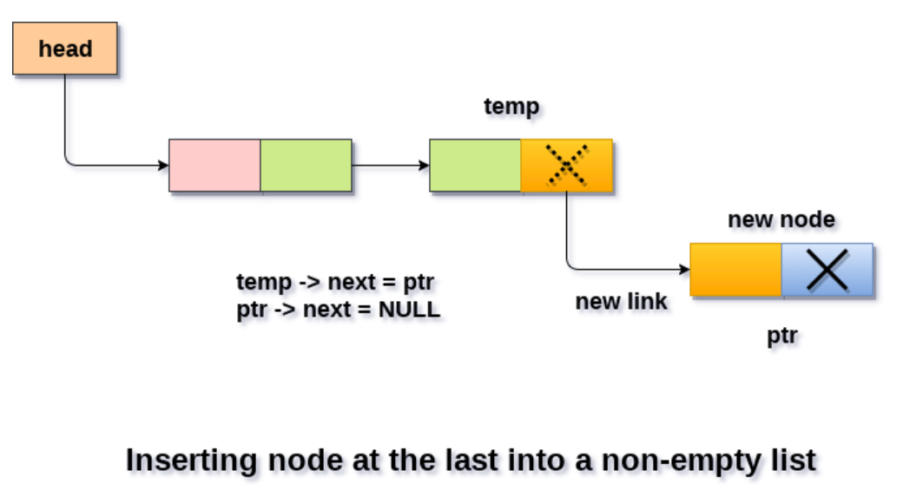
Algorithm
Step 1: IF PTR = NULL Write OVERFLOW Go to Step 1 [END OF IF]
Step 2: SET NEW_NODE = PTR
Step 3: SET PTR = PTR - > NEXT
Step 4: SET NEW_NODE - > DATA = VAL
Step 5: SET NEW_NODE - > NEXT = NULL
Step 6: SET PTR = HEAD
Step 7: Repeat Step 8 while PTR - > NEXT != NULL
Step 8: SET PTR = PTR - > NEXT [END OF LOOP]
Step 9: SET PTR - > NEXT = NEW_NODE
Step 10: EXIT

Slide 13
Insertion in singly linked list after specified Node
In order to insert an element after the specified number of nodes into the linked list, we need to skip the desired number of elements in the list to move the pointer at the position after which the node will be inserted. This will be done by using the following statements.
emp=head;
for(i=0;i<loc;i++)
{
temp = temp->next;
if(temp == NULL)
{
return;
}
}
Allocate the space for the new node and add the item to the data part of it. This will be done by using the following statements.
ptr = (struct node *) malloc (sizeof(struct node));
ptr->data = item;
Now, we just need to make a few more link adjustments and our node at will be inserted at the specified position. Since, at the end of the loop, the loop pointer temp would be pointing to the node after which the new node will be inserted. Therefore, the next part of the new node ptr must contain the address of the next part of the temp (since, ptr will be in between temp and the next of the temp). This will be done by using the following statements.
ptr→ next = temp → next
now, we just need to make the next part of the temp, point to the new node ptr. This will insert the new node ptr, at the specified position.
temp ->next = ptr;

Slide 14
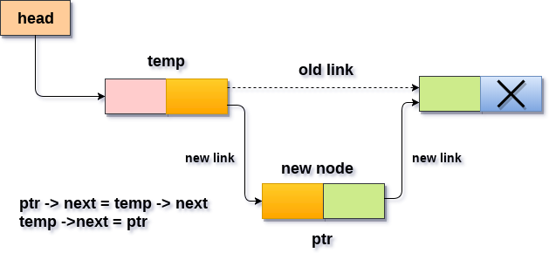
Algorithm STEP 1: IF PTR = NULL WRITE OVERFLOW GOTO STEP 12 END OF IF STEP 2: SET NEW_NODE = PTR STEP 3: NEW_NODE → DATA = VAL STEP 4: SET TEMP = HEAD STEP 5: SET I = 0 STEP 6: REPEAT STEP 5 AND 6 UNTIL I STEP 7: TEMP = TEMP → NEXT STEP 8: IF TEMP = NULL WRITE "DESIRED NODE NOT PRESENT" GOTO STEP 12 END OF IF END OF LOOP STEP 9: PTR → NEXT = TEMP → NEXT STEP 10: TEMP → NEXT = PTR STEP 11: SET PTR = NEW_NODE STEP 12: EXIT

Slide 15
Deletion in singly linked list after the specified node :
In order to delete the node, which is present after the specified node, we need to skip the desired number of nodes to reach the node after which the node will be deleted. We need to keep track of the two nodes. The one which is to be deleted the other one if the node which is present before that node. For this purpose, two pointers are used: ptr and ptr1.

Slide 16
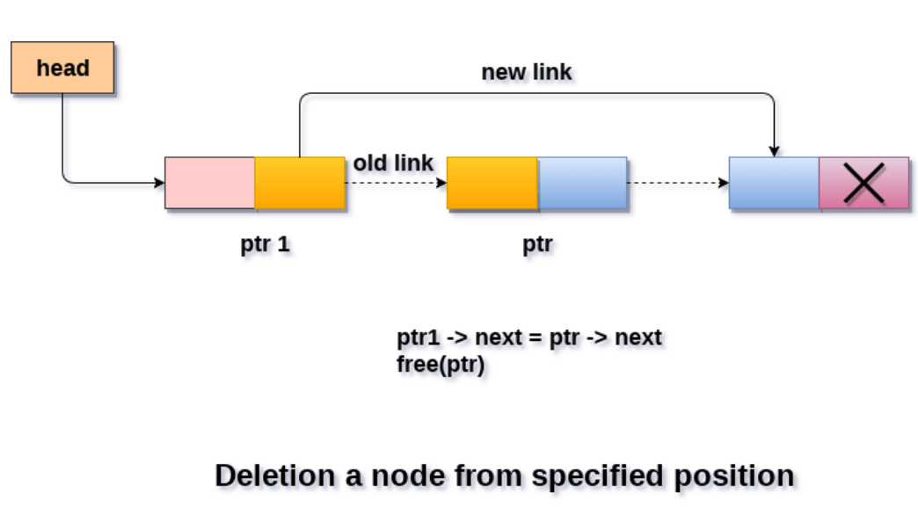
Make the next of ptr1 (points to the specified node) point to the next of ptr (the node which is to be deleted).
ptr1 ->next = ptr ->next;
free(ptr);
STEP 1: IF HEAD = NULL WRITE UNDERFLOW GOTO STEP 10 END OF IF
STEP 2: SET TEMP = HEAD
STEP 3: SET I = 0
STEP 4: REPEAT STEP 5 TO 8 UNTIL I
STEP 5: TEMP1 = TEMP
STEP 6: TEMP = TEMP → NEXT
STEP 7: IF TEMP = NULL
WRITE "DESIRED NODE NOT PRESENT" GOTO STEP 12 END OF IF
STEP 8: I = I+1
END OF LOOP
STEP 9: TEMP1 → NEXT = TEMP → NEXT
STEP 10: FREE TEMP
STEP 11: EXIT

Slide 17
Search an element in a Linked List
Initialize a node pointer, current = head.
Do following while current is not NULL
If the current value (i.e., current->key) is equal to the key being searched return true.
Otherwise, move to the next node (current = current->next).
If the key is not found, return false

